Slide 1





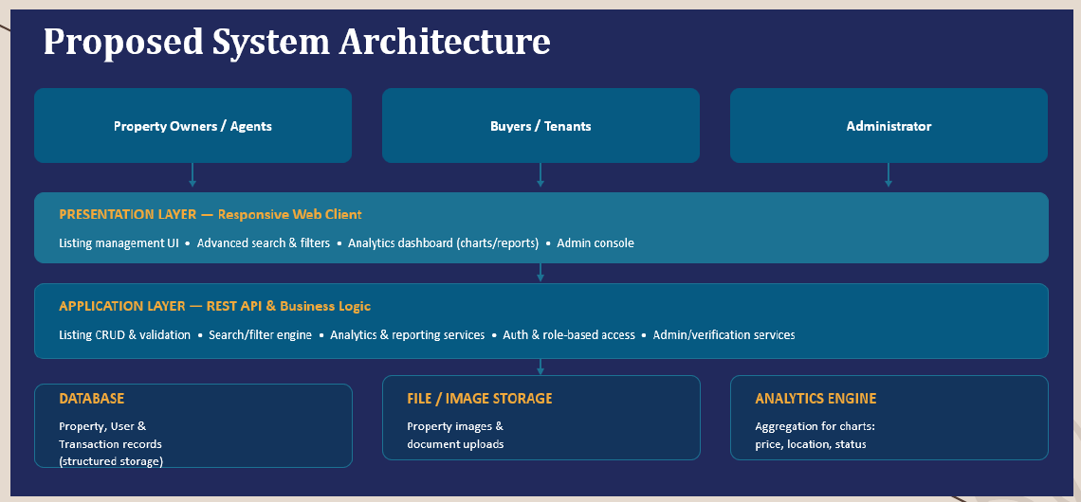


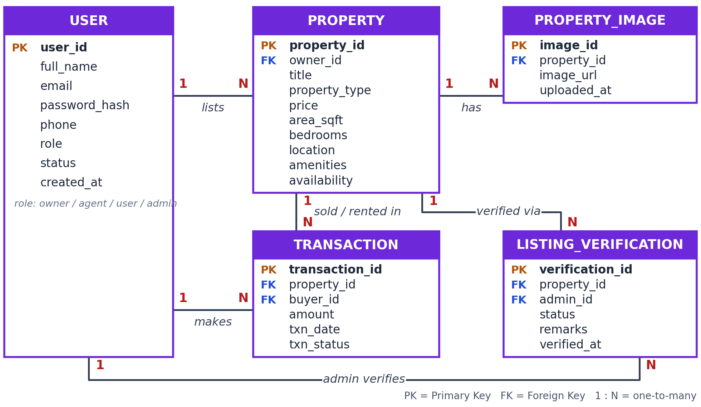


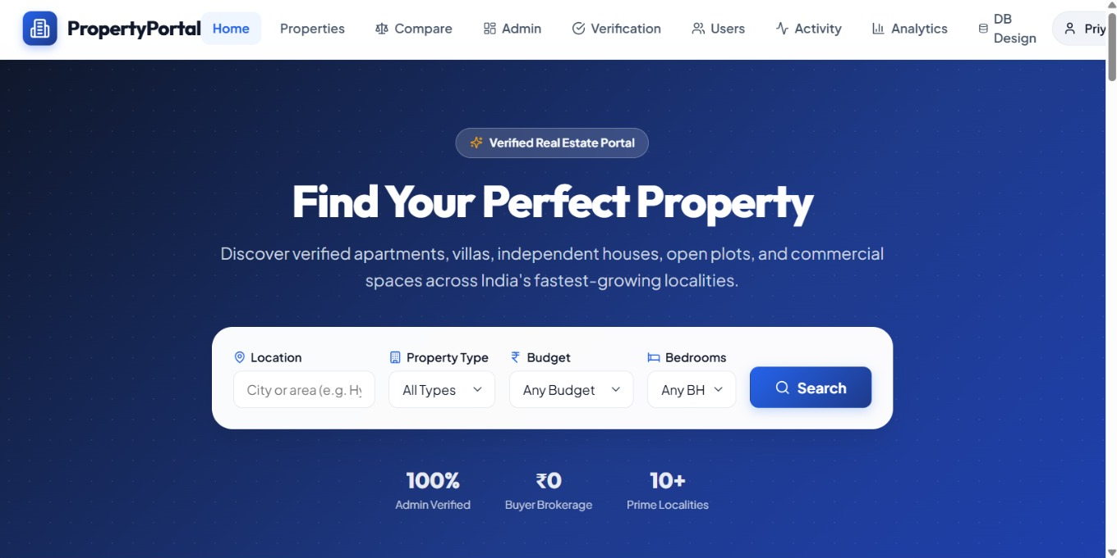
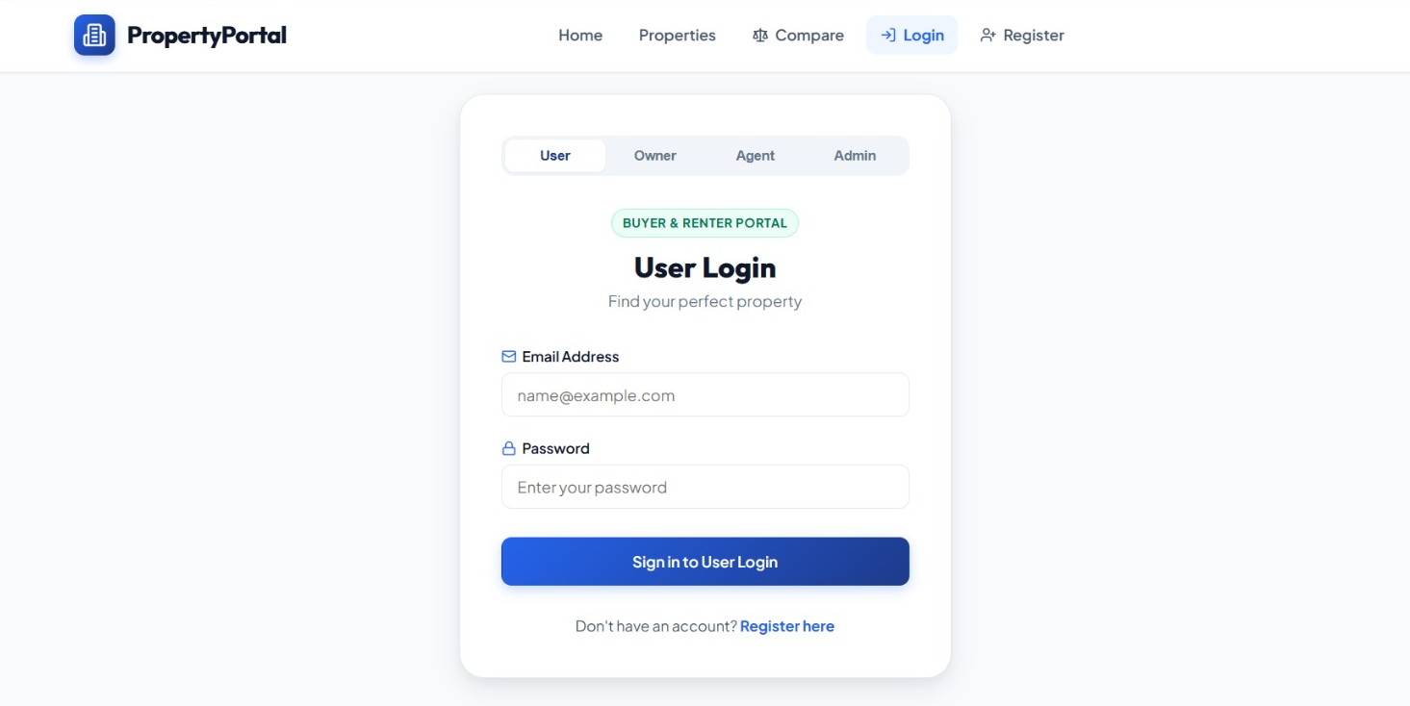




PROPERTY LISTING MANAGEMENT & ANALYTICS PORTAL
Team No: 21 | Section: 2 | Guide: Dr. Sateesh Kumar Ramatenki
Members: P. Nithya Sai – 2520030517, D. Namith Rao – 2520030249, T. HimaBindu Sree – 2520030484
Database Systems Engineering and Distributed Backend Development (25CS1302E) | KLH Bachupally Campus, CSE | PBL 2026-27
Abstract
Tools & Technologies
A web-based portal centralizing property management for owners, agents and users, with listing CRUD, advanced search/filtering, analytics dashboards and admin verification.
Outcome: faster property discovery, organized listings and visual analytics.
Front-End: HTML5, CSS3, JavaScript, React.js
Back-End: Node.js, Express.js + REST APIs
Database: MySQL
Tools: Visual Studio Code, Git / GitHub
Problem Statement & Objectives
System Architecture
Problem: Scattered property data, manual listing management, difficult search/comparison, and no centralized analytics or admin monitoring.
Objective 1: Centralize property information and listing management
Objective 2: Search/filter by location, price, type, area, bedrooms, amenities and availability
Objective 3: Provide analytics dashboards and admin verification/monitoring
Existing vs Proposed System
Feature | Existing System | Proposed System
Listings | Scattered data, manual work | Centralized, easy add/update/delete
Search | Basic search only | Advanced multi-criteria search
Analytics | Limited analytics | Analytics dashboard with charts
Monitoring | Hard to monitor listings | Admin verification/monitoring
Gap | Less organized, slow | Structured, faster, efficient
ER Diagram & Database Design
Feasibility Study
Technical: React.js, Node.js, Express.js and MySQL are widely available, well-documented tools.
Economic: Built on an open-source stack, so no licensing cost.
Operational: Centralized listings, search/filtering, analytics and admin verification support the intended workflow.
Schedule: Planned for completion within the semester timeline.
Implementation Screenshots
Home page: property search & filters
Login page: role-based access
Results & Testing
Conclusion
Future Scope
Property CRUD operations tested
Search and filters work correctly
Role-based login: User, Owner, Agent, Admin
Admin verification and analytics verified
MySQL connectivity and REST APIs checked
Provides a centralized platform for property management and improves property discovery
Helps owners and agents manage listings and supports analysis through dashboards
AI-based property recommendations
Virtual property tours
Mobile application development
Predictive property price analytics
Secure online booking and payments
Cloud deployment for scalability
Enhanced security and multilingual support
Property Search Made Simple
KLH Bachupally Campus | Team No: 21 | Section: 2
References: Project presentation supplied by the team | Technologies: React.js, Node.js, Express.js, MySQL

